Slide 1


SMART INDIA HACKATHON 2024
TITLE PAGE
Problem Statement ID – 1612
Problem Statement Title- Health Data Information & Management System Mobile Application (HDIMS)
Theme- HealthTech
PS Category- Software
Team ID- 46-07
Team Name- Hacksol24

Slide 2
IDEA TITLE
Hacksols24
Proposed Solution:
The Health Management System (HMS) mobile app named as ZEECARE provides a comprehensive solution for managing and streamlining healthcare data collection, monitoring, and policy implementation. The app is designed for hospitals, health departments, and government officials to efficiently manage health and family welfare schemes, track physical performance, and support policy formulation at various administrative levels. Below are the key details of the solution:
REAL TIME DATA ENTRY 6) MULTI - FACTOR AUTHENTICATION
REAL TIME BED AVAILABILITY 7) HIERARCHICAL DATA FLOW
GEOLOCATION BASED SEARCH
OFFLINE FUNCTIONALITY
ROLE BASED ACCESS CONTROL
By incorporating a bed booking feature, our healthmanagment app distinguishes itself by offering a practical solution for real-time bed management and hospital admissions. This feature enhances patient convenience, streamlines hospital operations, and leverages technology to address a critical aspect of healthcare service delivery.
8) HANDICAPPED SPECIALITY

Slide 3
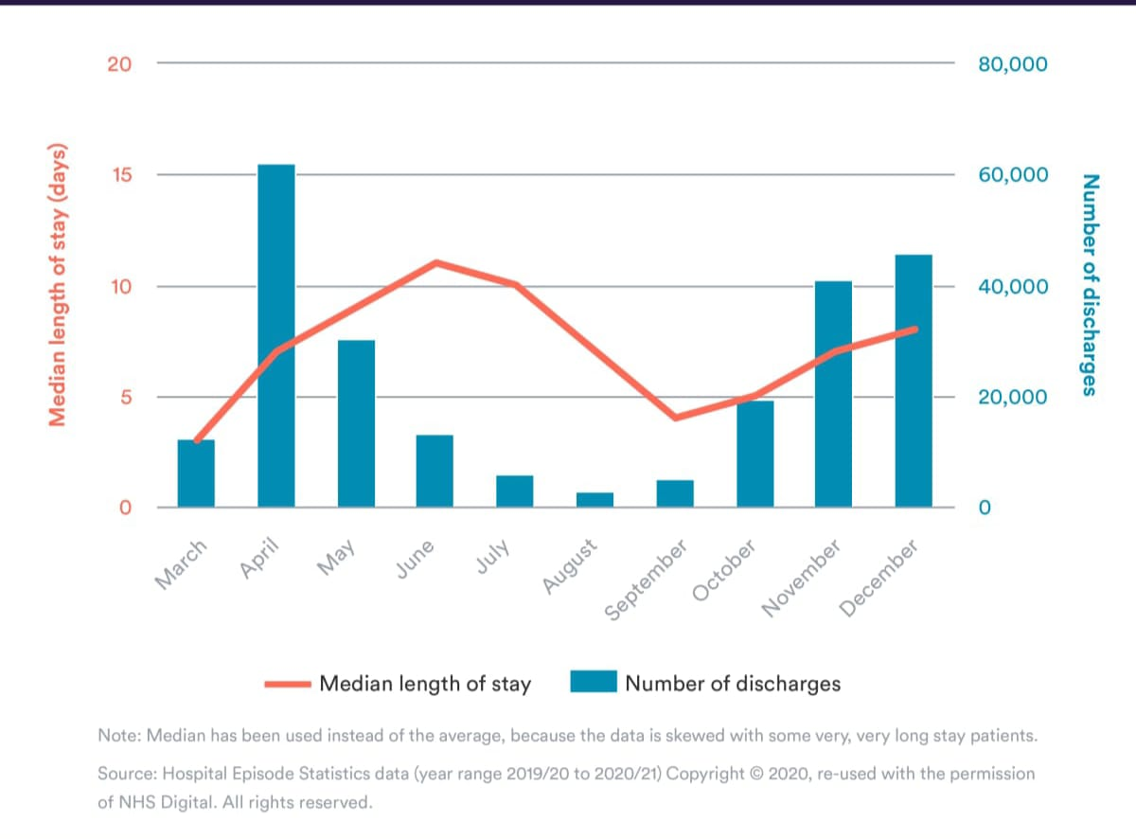
TECHNICAL APPROACH
Hacksols24
Technologies to be used :
1)websocket and API for Real-Time integration
2) geofencing for geolocation services
3)mongodb andSQLite3 for database
4) cross platform framework such that-
kivy
react native
nodeAPI
5)Augumented Reality
6)TLS for security and data encryption
7)AI powered Chatbot
8)HIE framework
9) powered BI
10) web3technology bitcoin transaction

Slide 4
FEASIBILITY AND VIABILITY
Hacksols24
Analysis of the feasibility of the idea:
The app’s data remains useful as long as there is a demand for health care services, which is unlikely to diminish. The app can offer value to hospitals and clinics by providing them with insights derived from the collected data, such as patient flow analytics, doctor performance metrics, or bed occupancy rates. All data collection will be based on informed consent from patients, ensuring that the app operates ethically.
STATEGIES
1. Conduct periodic security audits and penetration testing to identify and address vulnerabilities before they can be exploited. Collect only the necessary data to reduce the potential impact in case of a breach.
2. Ensure that explicit consent is collected from users, with clear privacy policies explaining how data will be used and stored. Implement comprehensive logging and audit trails to track data access and modifications, as required by many health care regulations
RISK AND POTENTIAL CHALLENGES
This risk can be mitigated by designing the app to be user-friendly and providing training resources for health care providers. Clear communication about the app’s security measures, data privacy policies, and benefits will help build trust. However, widespread adoption may require significant marketing and outreach efforts.

Slide 5
IMPACT AND BENEFITS
Hacksols24
Improved Access to Care: Patients can easily locate and book beds in real-time, ensuring timely admission, especially in critical conditions.Optimized Resource
Allocation: Hospitals and healthcare facilities can manage their bed resources more effectively, reducing inefficiencies and overcrowding.Enhanced Patient
Experience: Patients and families benefit from the convenience of booking beds in advance, reducing anxiety and uncertainty in emergency or planned situations.
Better Public Health Outcomes: Governments and healthcare providers can make data-driven decisions on resource allocation and policy-making.Reduction in
Health Disparities: Programs targeting rural, underserved, or vulnerable populations benefit from equal access to hospital resources, reducing healthcare inequality.Increased
Operational Efficiency: Automated bed management systems free up hospital staff from administrative burdens, allowing them to focus on patient care.

Slide 6
RESEARCH AND REFERENCES
Hacksols24
YOUTUBE
GEEKS FOR GEEKS
CHATGPT
BLACKBOXAI
COPILET
META AI
THESIS OF DEATH OCCUR
GOVERNMENT HOSPITAL STAFFS

